Slide 1
BRFSS Behavioral Risk Factor Surveillance System
Analysis Outcomes

Slide 2
Introduction
BRFSS is a public health survey conducted by CDC in the United States every year
It is a survey data provides valuable insights into the health status and behaviors of individuals across different states and territories in the US
It is considered as an important resource for advancing public health research and policy
Data Set Details:
Rows: 4,38,693 Columns: 304
Data Link: https://www.cdc.gov/brfss/annual_data/annual_2021.html
Year: 2021 to 2022
Location: 50 states, district of Columbia and 3 U.S. territories
Survey collects data of health-related risk behaviors, chronic health conditions and use of preventive services

Slide 3
Indicator Focused Analysis
Quality of Life (age & race-adjusted)
Poor or fair health Percentage of adults reporting fair or poor health
Poor physical health days Average number of physically unhealthy days reported in past 30 days
Poor mental health days Average number of mentally unhealthy days reported in past 30 days
Tobacco Use (age & race-adjusted)
Adult smoking Percentage of adults who are current smokers
Diet and Exercise (age & race-adjusted)
Adult obesity Percentage of the adult population (age 18 and older) that reports a body mass index (BMI) greater than or equal to 30 kg/m2
Physical inactivity Percentage of adults aged 18 and over reporting no leisure-time physical activity
Alcohol and Drug Use (age & race-adjusted)
Excessive drinking Percentage of adults reporting binge or heavy drinking

Slide 4
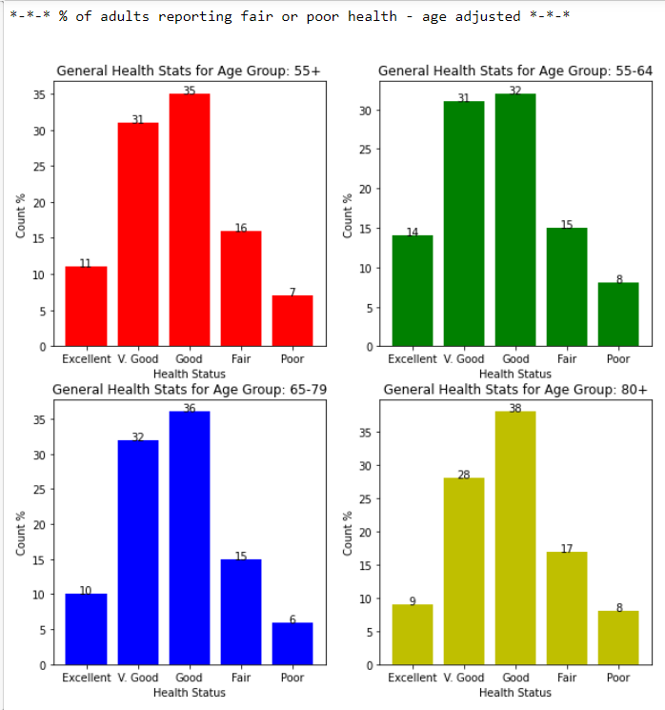
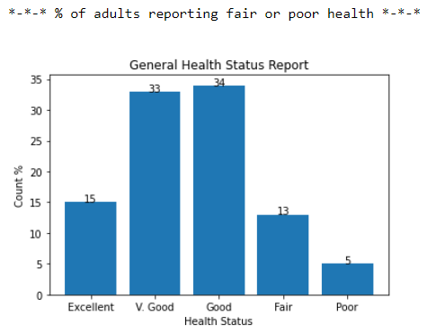
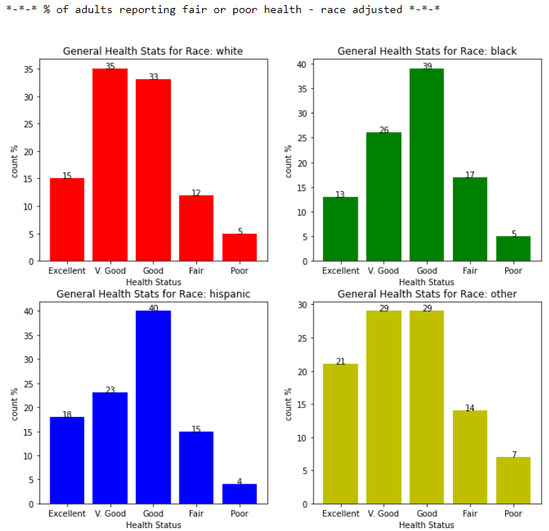
Quality of Life (Poor/Fair): Percentage of adults reporting fair or poor health (normal | age | race)
Notes:
1. Quality of Life
1.1 Poor or fair health: Percentage of adults reporting fair or poor health
1.1.1 Poor or fair health: Age adjusted
1.1.2 Poor or fair health: Race adjusted

Slide 5
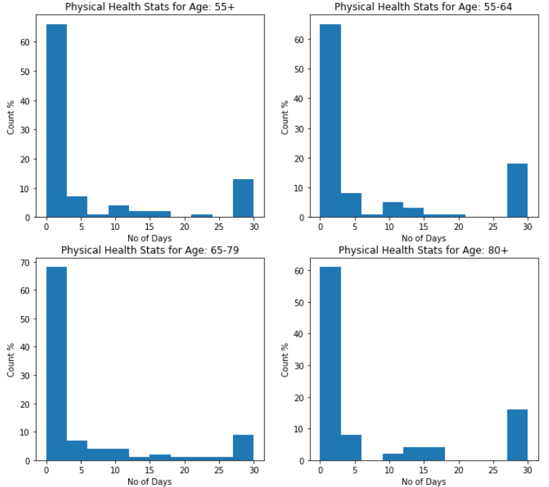
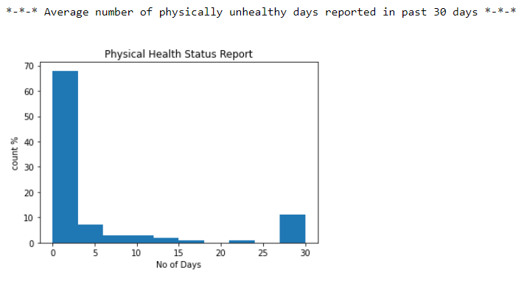
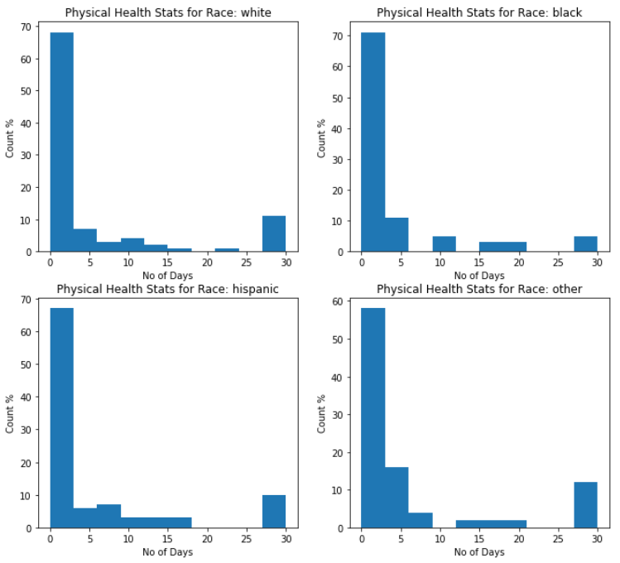
Quality of Life (physical): Average number of physically & mentally unhealthy days reported in past 30 days (normal | age | race).
Notes:
1.2 Poor physical health days
1.2.1 Poor physical health days: Age adjusted.
1.2.2 Poor physical health days: Race adjusted.

Slide 6
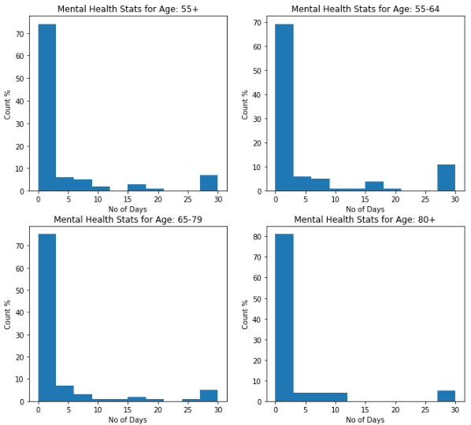
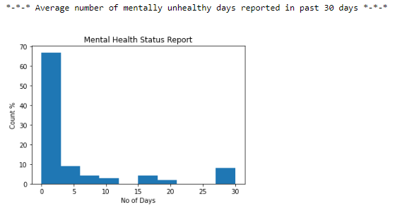
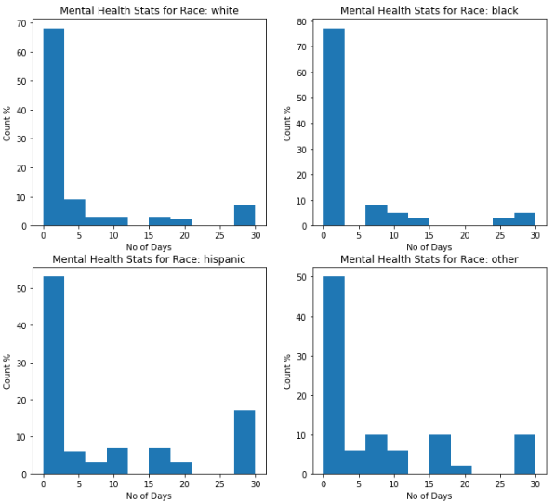
Quality of Life (Mental): Average number of physically & mentally unhealthy days reported in past 30 days (normal | age | race).
Notes:
1.3. Poor mental health days: Average number of mentally unhealthy days reported in past 30 days
1.3.1 Poor mental health days: Average number of mentally unhealthy days reported in past 30 days (age-adjusted).
1.3.2 Poor mental health days: Average number of mentally unhealthy days reported in past 30 days (race-adjusted)

Slide 7
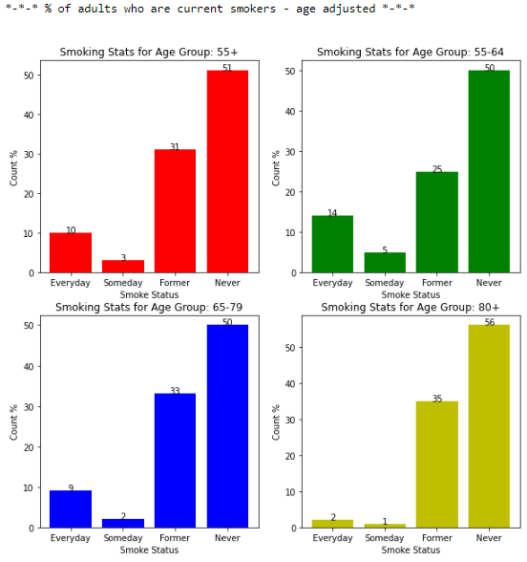
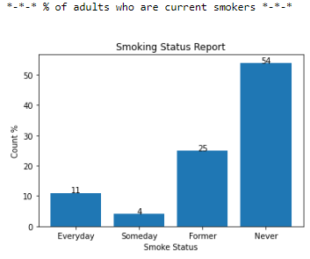
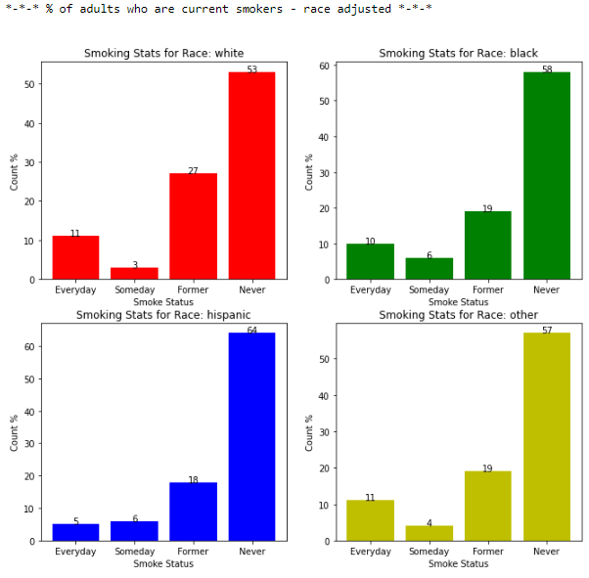
Tobacco Use (Smoking): Percentage of adults who are current smokers (normal | age | race).
Notes:
2. Tobacco Use
2.1. Adult Smoking: Percentage of adults who are current smokers.
2.1.1 Adult Smoking: Percentage of adults who are current smokers (age-adjusted).
2.1.2 Adult Smoking: Percentage of adults who are current smokers (race-adjusted).

Slide 8
Diet & Exercise (Obesity): Percentage of adults whose BMI >25 (normal | age | race).
Age Adjusted | %
Age Grp 55+ | 63.75
Age Grp 55-64 | 66.22
Age Grp 65-79 | 65.72
Age Grp 80+ | 51.61
% of Adult population that reports BMI>=25
61.74%
Race Adjusted | %
White | 62.42
Black | 67.09
Hispanic | 61.2
Other | 54.73
Notes:
3. Diet & Exercise
3.1 Adult Obesity - BMI > 25: Percentage of the adult population (age 18 and older) that reports a body mass index (BMI) greater than or equal to 25 kg/m2 (age-adjusted).
3.1.2 Adult Obesity - BMI > 30: Percentage of the adult population (age 18 and older) that reports a body mass index (BMI) greater than or equal to 30 kg/m2 (race-adjusted).

Slide 9
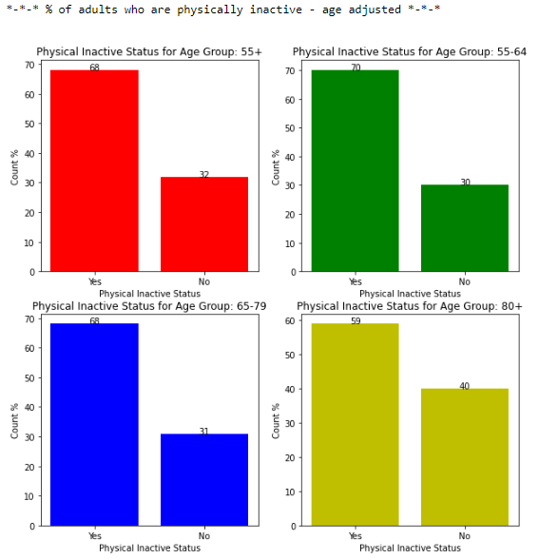
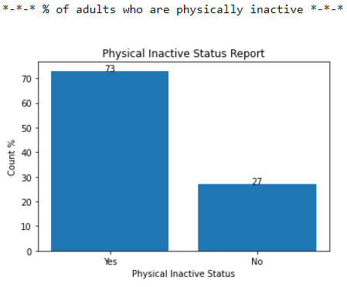
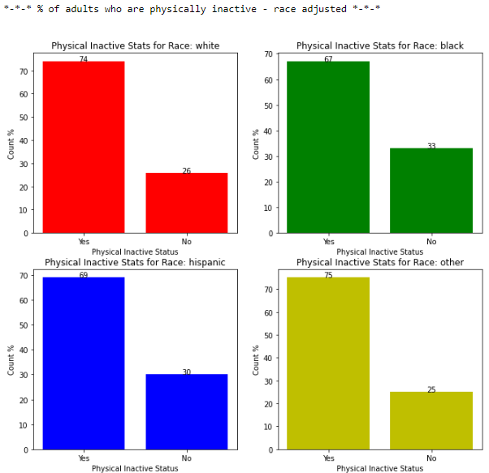
Diet & Exercise (Physical In-activity): Percentage of adults reported no leisure-time physical activity (normal | age | race).
Notes:
3.2 Physical inactivity: Percentage of adults age 18 and over reporting no leisure-time physical activity.
3.2.1 Physical inactivity: Percentage of adults age 18 and over reporting no leisure-time physical activity (age-adjusted).
3.2.2 Physical inactivity: Percentage of adults age 18 and over reporting no leisure-time physical activity (race-adjusted).

Slide 10
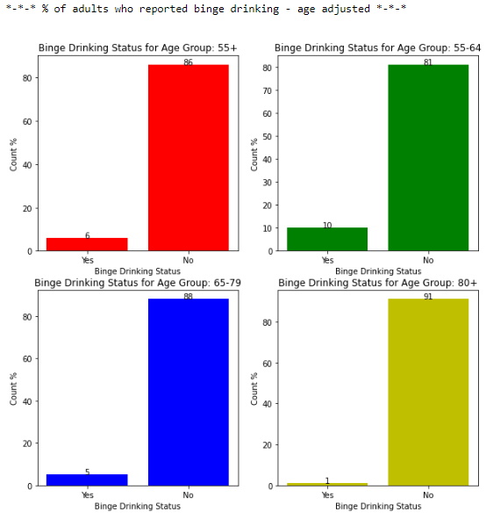
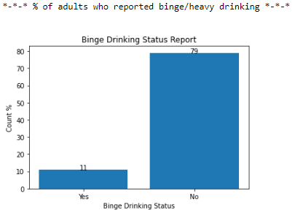
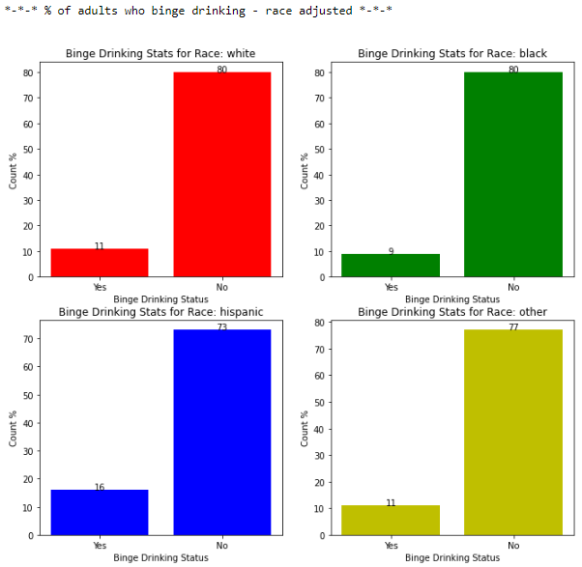
Alcohol & Drug Use (Excessive Drinking): Percentage of adults reporting binge/heavy drinking (normal | age | race).
Notes:
4. Alcohol & Drug Use
4.1 Excessive Drinking: Percentage of adults reporting binge or heavy drinking (age-adjusted)
4.1.2 Excessive Drinking: Percentage of adults reporting binge or heavy drinking (race-adjusted)

Slide 11
Conclusion
Quality of Life:
The percentage of individuals reporting fair health is higher among the 80+ age group and the Black race.
The highest number of physically unhealthy days is observed in the 55-64 and 80+ age groups, while the lowest is reported among the Black race.
The 55-64 age group and Hispanic individuals experience comparatively higher mentally unhealthy days.
Tobacco Use:
Current smokers are prevalent in the 55-64 age group, as well as among White and Black individuals.
Diet and Exercise:
The 55-64 age group and the Black race have higher obesity rates compared to other groups.
Analysis indicates that the 55-64 age group has the lowest level of physical inactivity, while the Black race is the most active group.
Alcohol and Drug Use:
Binge drinking is highest among the 55-64 age group and the Hispanic race.

Slide 12
Thank You
Team COMET Lab

Slide 13
References
Data Set:
https://www.cdc.gov/brfss/annual_data/annual_2021.html
Source Code:
https://github.com/iam-neelesh8/BRFSS_Analysis/blob/main/notebooks/BRFSS_EDA.ipynb
Accessible to IU only:
BRFSS Documentation.docx
CDC Website:
https://chronicdata.cdc.gov/Behavioral-Risk-Factors/Behavioral-Risk-Factor-Surveillance-System-BRFSS-P/dttw-5yxu

